Slide 1
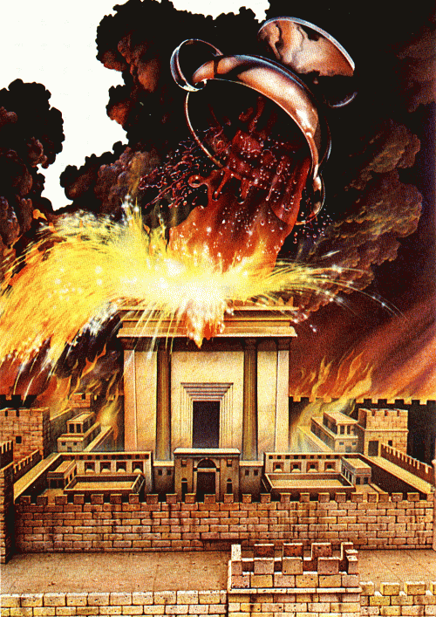
The Final Wrath
391
The Bowl Judgments of Rev. 15–16
Rick Griffith • Crossroads International Church • BibleStudyDownloads.org

Slide 2
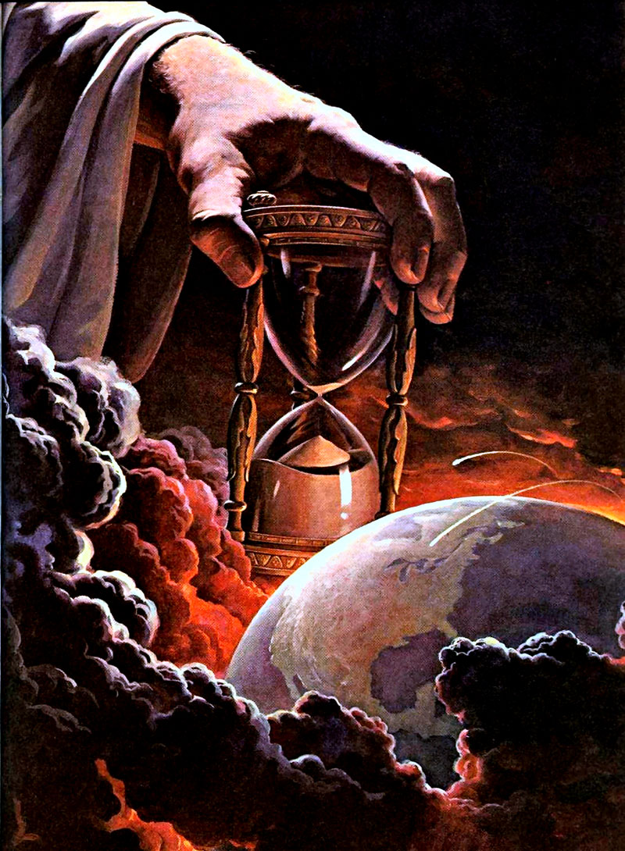
What right does God have to judge?

Slide 3
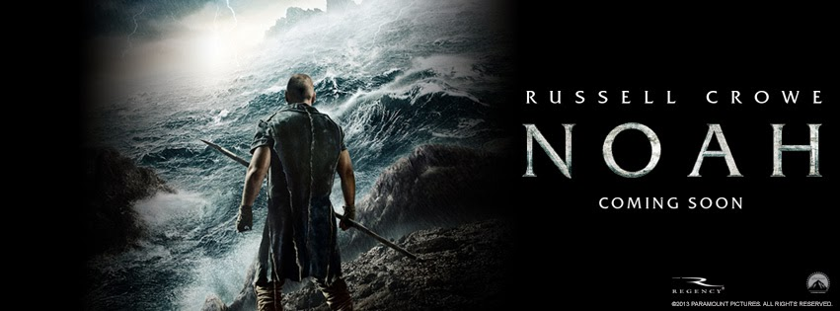
Noah
Shadowed

Slide 4
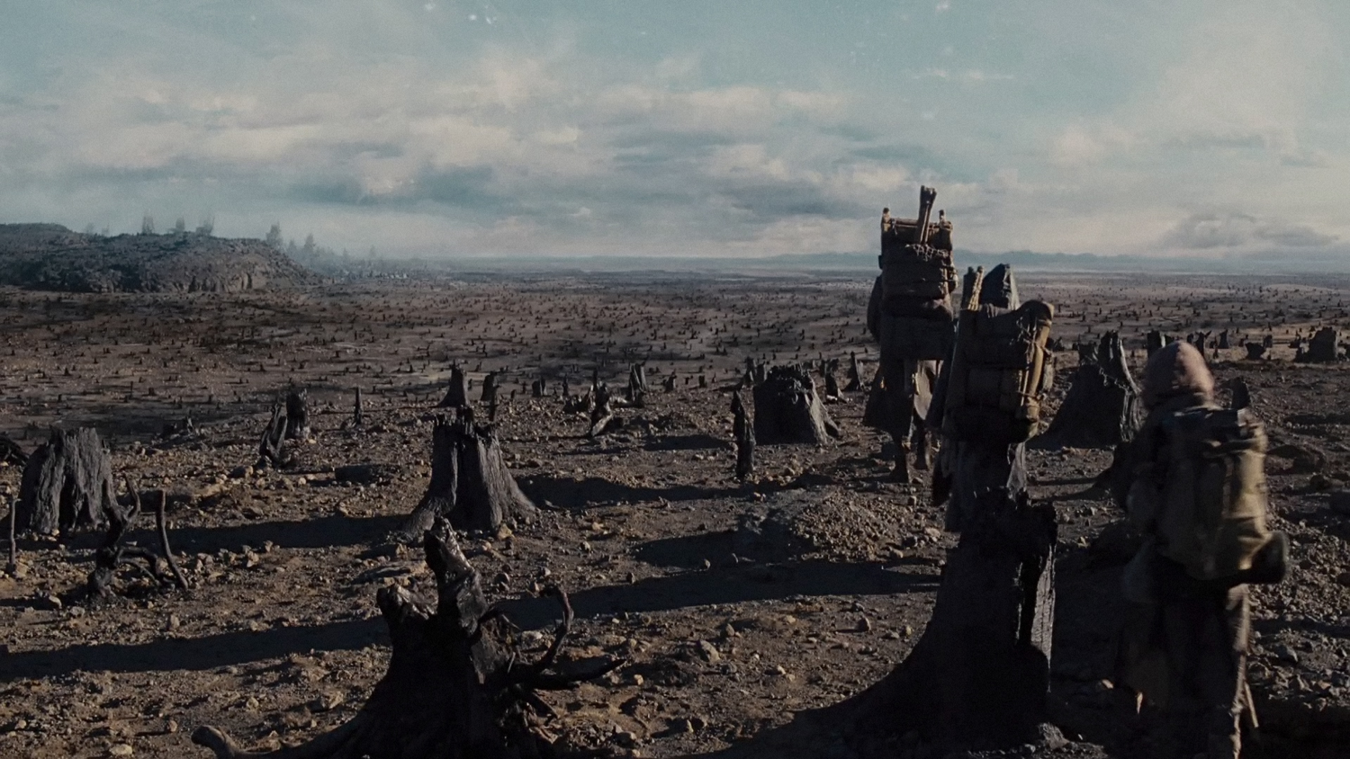
Noah
The earth must be destroyed due to man not taking care of the environment!

Slide 5
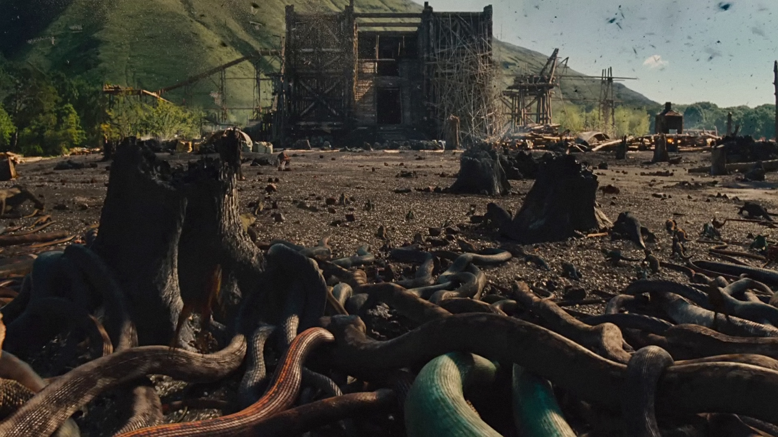
Noah
Snake infestation

Slide 6
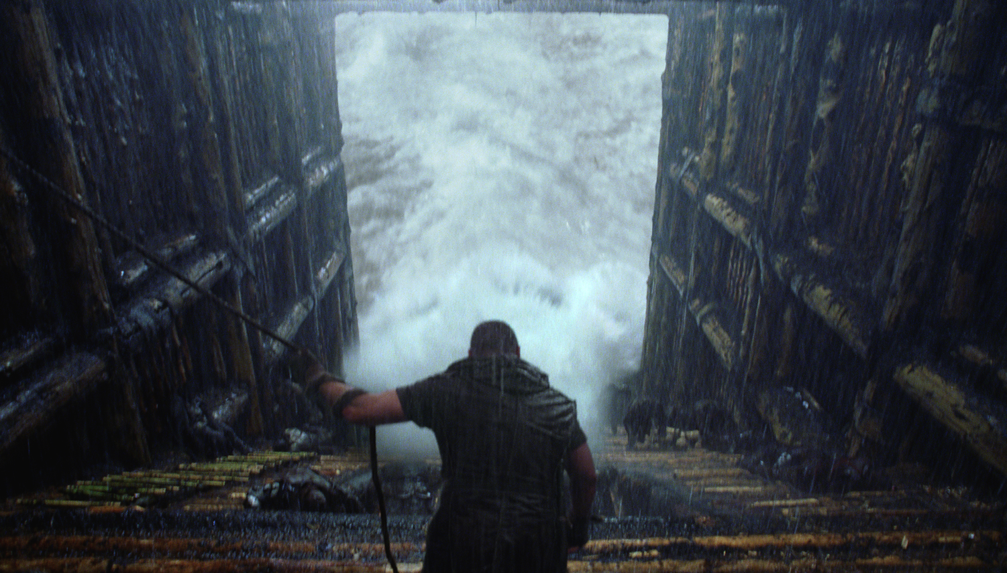
Noah
Who closed the door seven days before the Flood?

Slide 7
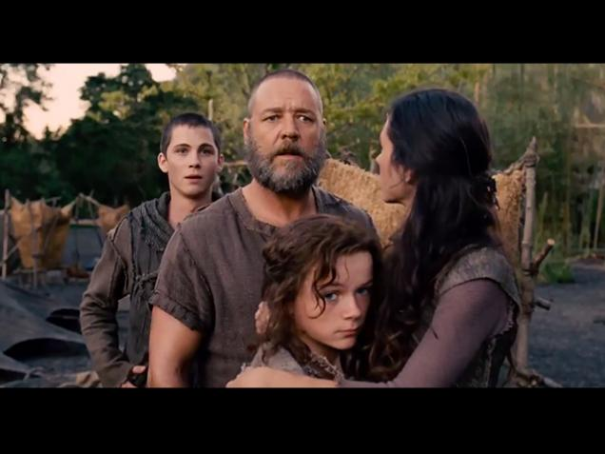
Noah
Where's Ham, Shem & Japheth?

Slide 8
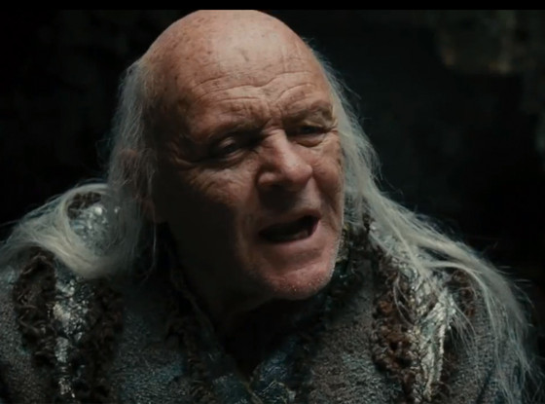
Noah
Methuselah the "witch doctor"

Slide 9
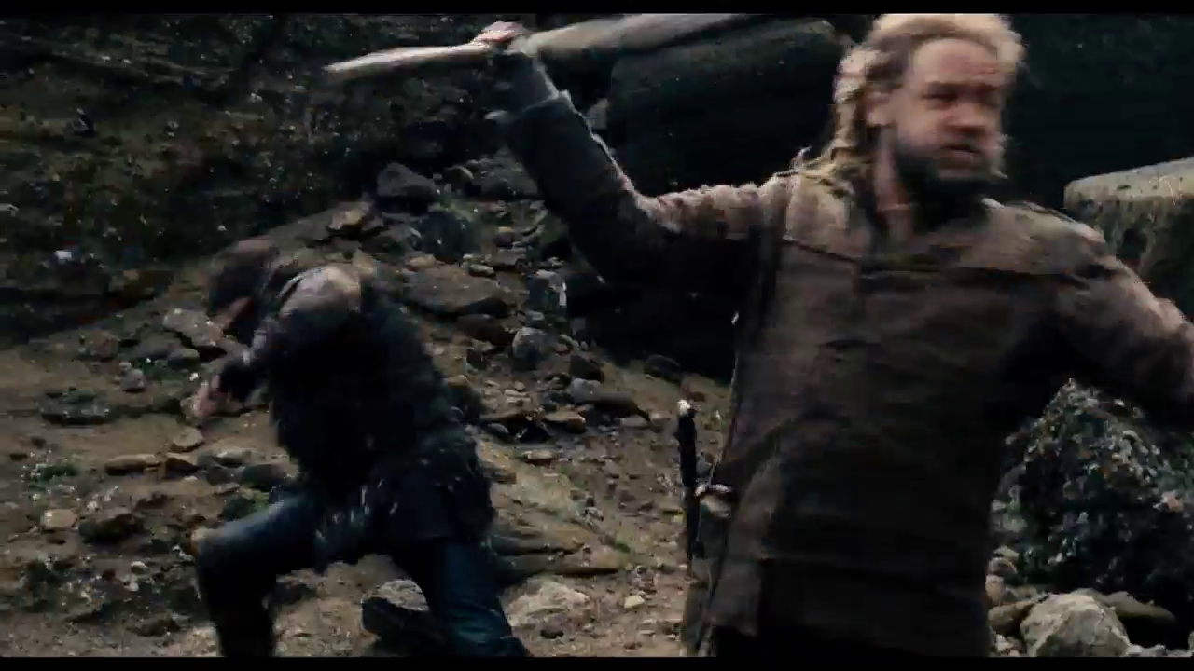
Noah
Shadowed

Slide 10
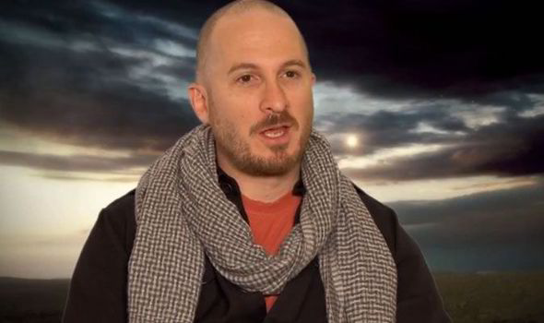
Atheist Producer Darren Aronofsky
The "most unbiblical" film about the Bible…

Slide 11
Ray Comfort's "Noah"
http://www.noahthemovie.com/

Slide 12
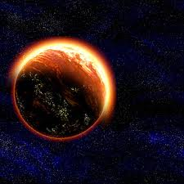
Does God have the right to judge the world?
Why?

Slide 13
Content of the Judgments
337
 | SEALS | TRUMPETS | BOWLS
1 | White: conqueror | Hail & fire thrown to earth: 1/3 vegetation burned | Bowl poured on earth: sores on unbelievers
2 | Red: war | Fire: 1/3 sea to blood | Sea to blood
3 | Black: famine | Star: 1/3 fresh water blood | Fresh water to blood
4 | Pale: death | Dark: 1/3 sun, moon, stars | Sun burns men
 |  | (Trumpets 5-7 are woes)
5 | Martyrs reassured | Woe #1: locusts & sun & sky darkened | Complete darkness on beast's kingdom
6 | Wrath: earthquake, signs | Woe #2: Euphrates prep | Euphrates dries up
 | (144,000 sealed) | (Trump #7 = mystery)
7 | 1/2 hour silence | Woe #3: victory imminent | Earthquake & hail, "it is done!"
H O R S E S
W O E S
Adapted from Robert Gromacki, NT Survey and H. Wayne House, Chronological & Background Charts of the NT, 19

Slide 14
Does God have the right to judge the world?
How?
Why?
Rev. 16
Rev. 15

Slide 15
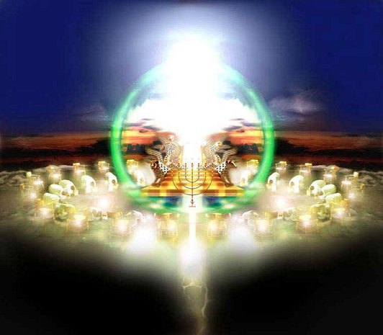
I. God alone is holy (Rev. 15).
Why does God have the right to judge the world?

Slide 16
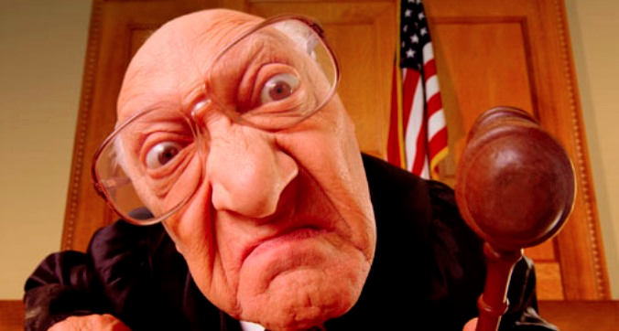
Is God an arbitrary judge?
Shadowed

Slide 17
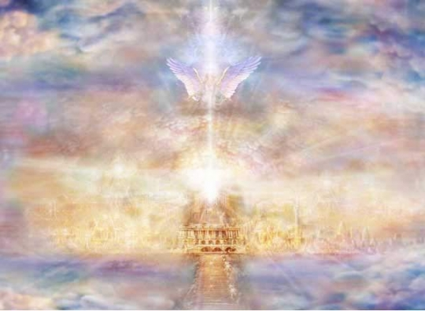
The Reality:
Holy = Judge
Not Holy = Judged

Slide 18
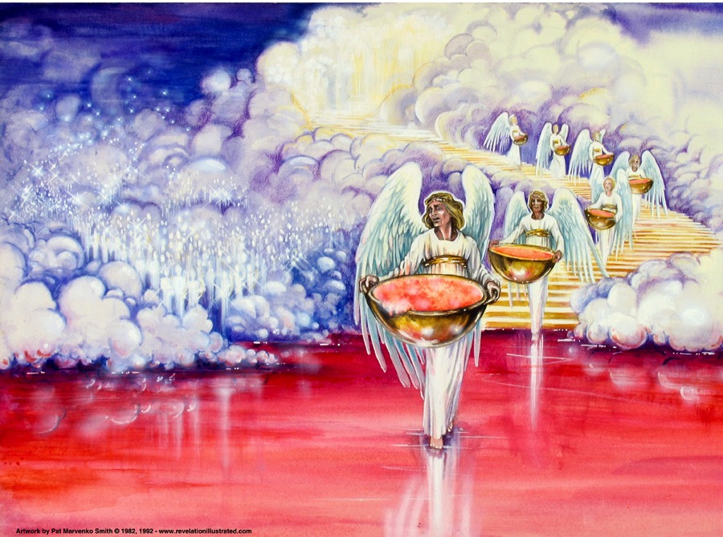
"Then I saw in heaven another marvelous event of great significance. Seven angels were holding the seven last plagues, which would bring God’s wrath to completion" (15:1 NLT).
392

Slide 19
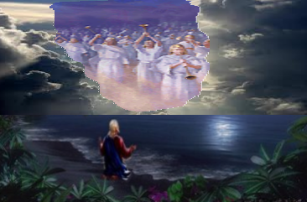
Tribulation Saints (15:2)
"I saw before me what seemed to be a glass sea mixed with fire. And on it stood all the people who had been victorious over the beast and his statue and the number representing his name. They were all holding harps that God had given them" (15:2 NLT).
391

Slide 20
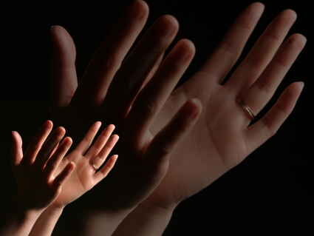
"And they were singing the song of Moses, the servant of God, and the song of the Lamb: 'Great and marvelous are your works, O Lord God, the Almighty. Just and true are your ways, O King of the nations. ⁴Who will not fear you, Lord, and glorify your name? For you alone are holy. All nations will come and worship before you, for your righteous deeds have been revealed'" (15:3-4 NLT).
Notes:
"The Tribulation saints whom John saw and heard were standing by the “sea of glass” in heaven (Rev. 4:6), just as the Israelites stood by the Red Sea. They were singing “the song of Moses” and also “the song of the Lamb.” “The song of Moses” is recorded in Exodus 15, and its refrain is: “The Lord is my strength and song, and He is become my salvation” (Ex. 15:2)" (Wiersbe).

Slide 21
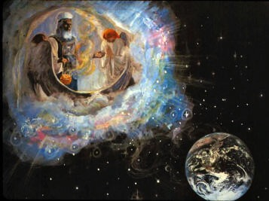
"Then I looked and saw that the Temple in heaven, God's Tabernacle, was thrown wide open" (15:5 NLT).

Slide 22
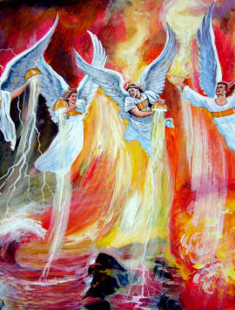
"The seven angels who were holding the seven plagues came out of the Temple. They were clothed in spotless white linen with gold sashes across their chests" (15:6 NLT).

Slide 23
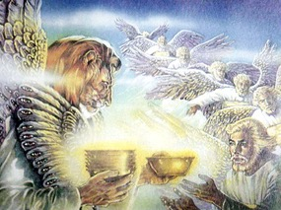
"Then one of the four living beings handed each of the seven angels a gold bowl filled with the wrath of God, who lives forever and ever" (15:7 NLT).

Slide 24
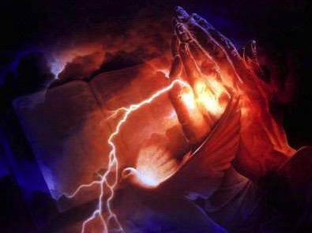
"The Temple was filled with smoke from God's glory and power. No one could enter the Temple until the seven angels had completed pouring out the seven plagues" (15:8 NLT).

Slide 25
I. God alone is holy (Rev. 15).
Why does God have the right to judge the world?
But how will he judge?

Slide 26
II. Christ will judge the earth through seven bowls before he returns (Rev. 16).
391
How will God judge the world?
1st
2nd
3rd
4th
5th
6th
7th
Sores afflict those who accepted the mark of the Beast (16:2)
Sea turns to blood; all sea creatures die (16:3)
Rivers turn to blood (16:4-7)
Mankind scorched by the sun, blasphemes God (16:8-9)
The Beast's seat of govern-ment is afflicted (16:10-11)
The Euphrates is dried up; world armies gather to Arma-geddon (16:12-16)
The earth is utterly shaken (16:17-21)

Slide 27
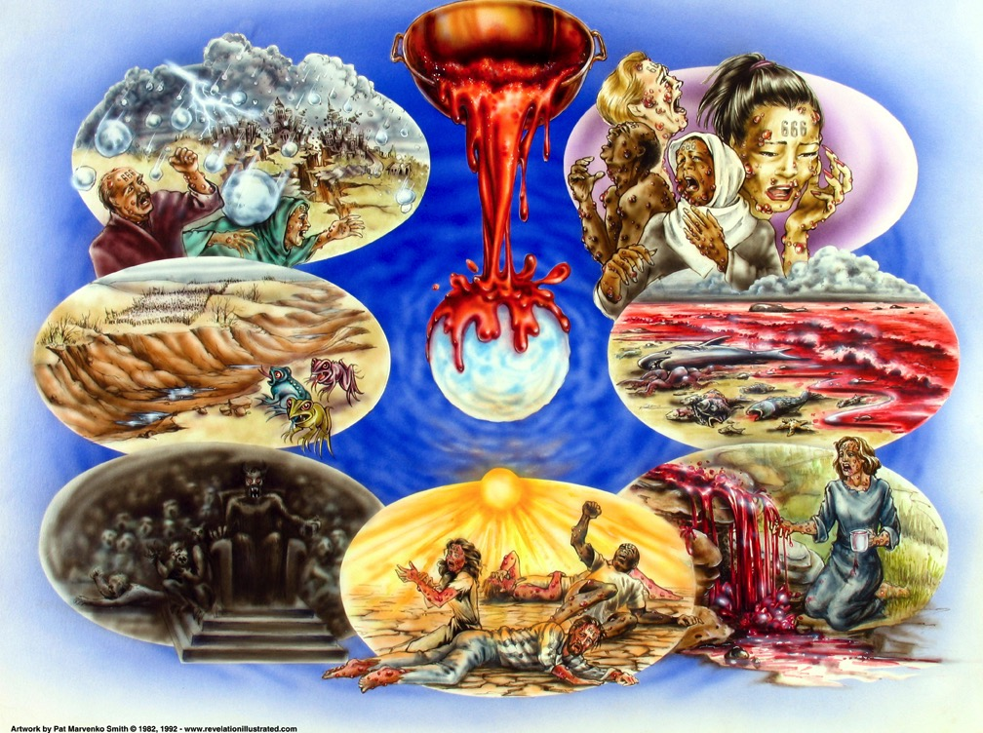
"Then I heard a mighty voice from the Temple say to the seven angels, 'Go your ways and pour out on the earth the seven bowls containing God’s wrath'" (16:1 NLT).
392
Used with permission

Slide 28
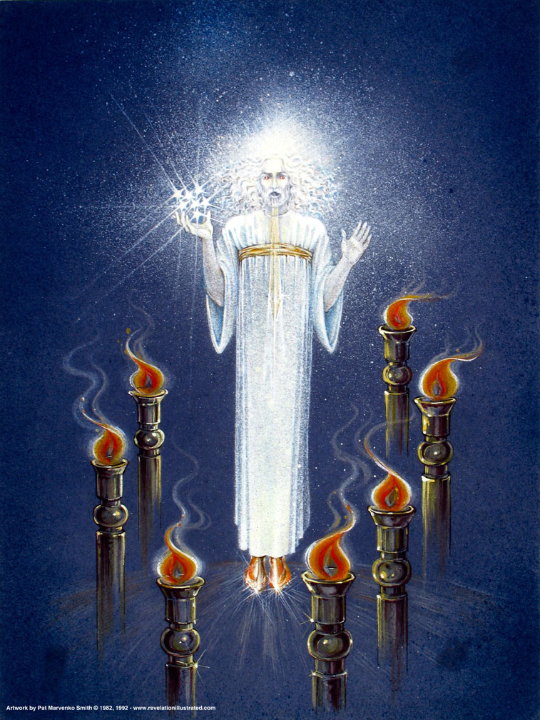
Christ Among the Lamp Stands (1:12-16)
Notes:
"Christ's garments are those of a Judge-King, One with honor and authority. The white hair symbolizes His eternality, "the Ancient of Days" (Dan. 7:9, 13, 22). His eyes see all (Rev. 19:12; Heb. 4:12), enabling Him to judge righteously. His feet of burning brass also suggest judgment, since the brazen altar was the place where the fire consumed the sin offering. The Lord had come to judge the churches, and He would also judge the evil world system" (Wiersbe).

Slide 29
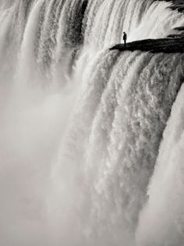
"…voice of many waters" (1:15)
Notes:
"The "sound of many waters" (Rev. 1:15) makes me think of Niagara Falls! Perhaps two ideas are suggested here: (1) Christ gathers together all the "streams of revelation" and is the Father's "last Word" to man (Heb. 1:1–3); (2) He speaks with power and authority and must be heard." (Wiersbe).

Slide 30
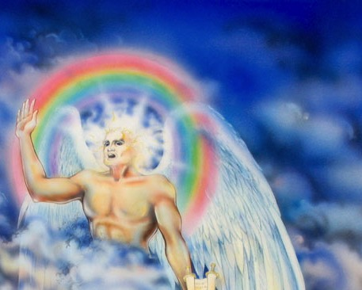
"Then I saw another mighty angel coming down from heaven, surrounded by a cloud, with a rainbow over his head. His face shone like the sun, and his feet were like pillars of fire" (10:1 NLT)
Notes:
"The fact that the angel's face is "as the sun" corresponds to the description of Jesus Christ in Revelation 1:16; his feet correspond to the Lord's description in Revelation 1:15. His voice like a lion suggests Revelation 5:5. This being could well be our Lord Jesus Christ, appearing to John as a kingly angel. Jesus often appeared in the Old Testament as "the Angel of the Lord" (Ex. 3:2; Jud. 2:4; 6:11–12, 21–22; 2 Sam. 24:16). This was a temporary manifestation for a special purpose, not a permanent incarnation.
Two other characteristics would suggest identifying the angel as Jesus Christ: the book in his hand and the awesome posture that he assumed. The little book contains the rest of the prophetic message that John will deliver. Since our Lord was the only One worthy to take the scroll and break the seals (Rev. 5:5ff), it might well be concluded that He is the only One worthy to give His servant the rest of the message.
The angel's posture is that of a conqueror taking possession of his territory. He is claiming the whole world (see Josh. 1:1–3). Of course, only the victorious Savior could make such a claim. The Antichrist will soon complete his conquest and force the whole world to submit to his control. But before that happens, the Savior will claim the world for Himself, the inheritance that His Father promised Him (Ps. 2:6–9). Satan roars like a lion to frighten his prey (1 Peter 5:8), but the Lion of Judah roars to announce victory (see Ps. 95:3–5; Isa. 40:12–17)" (Wiersbe).

Slide 31
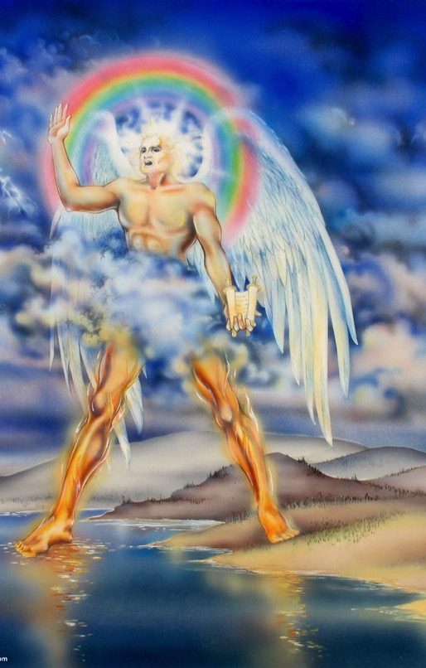
"And in his hand was a small scroll that had been opened. He stood with his right foot on the sea and his left foot on the land. ³And he gave a great shout like the roar of a lion. And when he shouted, the seven thunders answered" (10:2-3 NLT).
Notes:
"The fact that the angel's face is "as the sun" corresponds to the description of Jesus Christ in Revelation 1:16; his feet correspond to the Lord's description in Revelation 1:15. His voice like a lion suggests Revelation 5:5. This being could well be our Lord Jesus Christ, appearing to John as a kingly angel. Jesus often appeared in the Old Testament as "the Angel of the Lord" (Ex. 3:2; Jud. 2:4; 6:11–12, 21–22; 2 Sam. 24:16). This was a temporary manifestation for a special purpose, not a permanent incarnation.
Two other characteristics would suggest identifying the angel as Jesus Christ: the book in his hand and the awesome posture that he assumed. The little book contains the rest of the prophetic message that John will deliver. Since our Lord was the only One worthy to take the scroll and break the seals (Rev. 5:5ff), it might well be concluded that He is the only One worthy to give His servant the rest of the message.
The angel's posture is that of a conqueror taking possession of his territory. He is claiming the whole world (see Josh. 1:1–3). Of course, only the victorious Savior could make such a claim. The Antichrist will soon complete his conquest and force the whole world to submit to his control. But before that happens, the Savior will claim the world for Himself, the inheritance that His Father promised Him (Ps. 2:6–9). Satan roars like a lion to frighten his prey (1 Peter 5:8), but the Lion of Judah roars to announce victory (see Ps. 95:3–5; Isa. 40:12–17)" (Wiersbe).

Slide 32
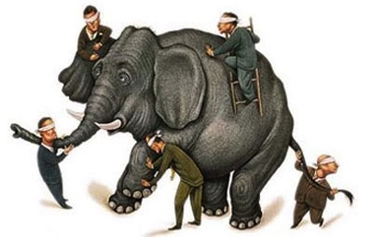
Discerning the Trumpets & Bowls

Slide 33
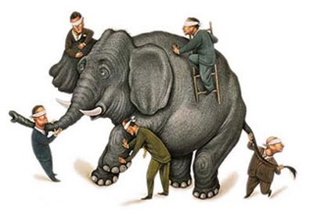
Beale, 808, on Trumpets & Bowls
"Both trumpets and bowls present the plagues in the same order: plagues striking
the earth,
(2) the sea,
(3) rivers,
(4) the sun,
(5) the realm of the wicked with darkness,
(6) the Euphrates (together with influencing the wicked by demons), and
(7) the world with the final judgment (with the same imagery of 'lightning, sounds, thunders, and earthquake' and 'great hail')"

Slide 34
Same Type of Judgment in the Same Order
Trumpets | Judgment | Bowls
1. 8:1-7 | The earth | 16:1-2
2. 8:8-9 | The sea | 16:3
3. 8:10-11 | The rivers | 16:4-7
4. 8:12-13 | The heavens | 16:8-9
5. 9:1-2 | Mankind—torment | 16:10-11
6. 9:13-21 | An army | 16:12-16
7. 11:15-19 | Angry nations | 16:17-21
Warren Wiersbe, Bible Exposition Commentary
Notes:
34

Slide 35
Bowl Judgments (Rev. 16)
392
1
Used with permission

Slide 36
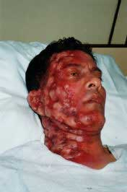
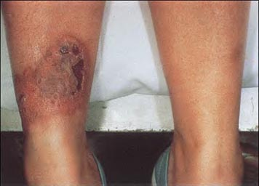
Bowl #1 (16:2)
392-393
"So the first angel left the Temple and poured out his bowl on the earth, and horrible, malignant sores broke out on everyone who had the mark of the beast and who worshiped his statue" (NLT).

Slide 37
Bowl Judgments (Rev. 16)
392
2
Used with permission

Slide 38
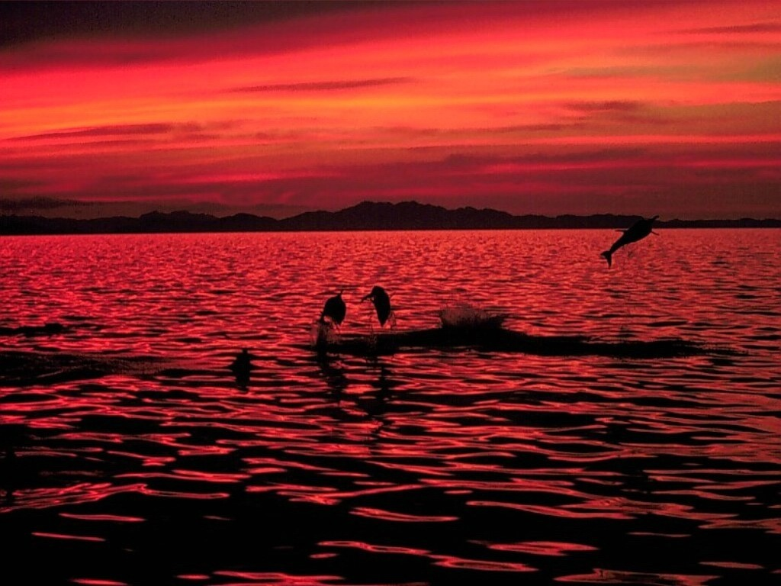
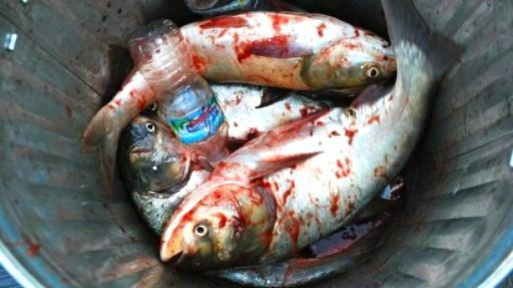
Bowl #2 (16:3)
392-393
"Then the second angel poured out his bowl on the sea, and it became like the blood of a corpse. And everything in the sea died" (NLT).

Slide 39
Bowl Judgments (Rev. 16)
392
3
Used with permission

Slide 40
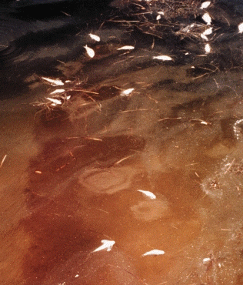
Bowl #3: All Fresh Water Turns to Blood (16:4-7)
393
"Then the third angel poured out his bowl on the rivers and springs, and they became blood" (16:4 NLT).

Slide 41
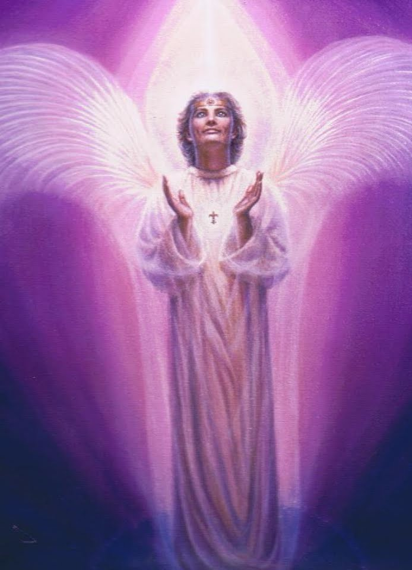
Bowl #3: Praise of God's Justice (16:5-7)
"And I heard the angel who had authority over all water saying, 'You are just, O Holy One, who is and who always was, because you have sent these judgments.
⁶Since they shed the blood of your holy people and your prophets, you have given them blood to drink. It is their just reward'" (NLT).
"And I heard a voice from the altar, saying, 'Yes, O Lord God, the Almighty, your judgments are true and just'" (NLT).

Slide 42
Bowl #3: Praise of God's Justice (16:5-7)
"Heaven gives justification for this terrible judgment: the earth-dwellers have shed the blood of God’s people, so it is only right that they should drink blood. In God’s government, the punishment fits the crime. Pharaoh tried to drown the Jewish boy babies, but it was his own army that eventually drowned in the Red Sea. Haman planned to hang Mordecai on the gallows and to exterminate the Jews; but he himself was hanged on the gallows, and his family was exterminated (Es. 7:10; 9:10). King Saul refused to obey God and slay the Amalekites, so he was slain by an Amalekite (2 Sam. 1:1–16)" (Wiersbe, Bible Exposition Commentary)

Slide 43
Bowl Judgments (Rev. 16)
392
4
Used with permission

Slide 44
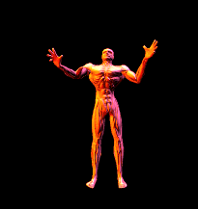
Bowl #4: The Sun Burns Men (16:8-9)
393
"Then the fourth angel poured out his bowl on the sun, causing it to scorch everyone with its fire. ⁹Everyone was burned by this blast of heat, and they cursed the name of God, who had control over all these plagues. They did not repent of their sins and turn to God and give him glory" (NLT).

Slide 45
Bowl Judgments (Rev. 16)
392
5
Used with permission

Slide 46
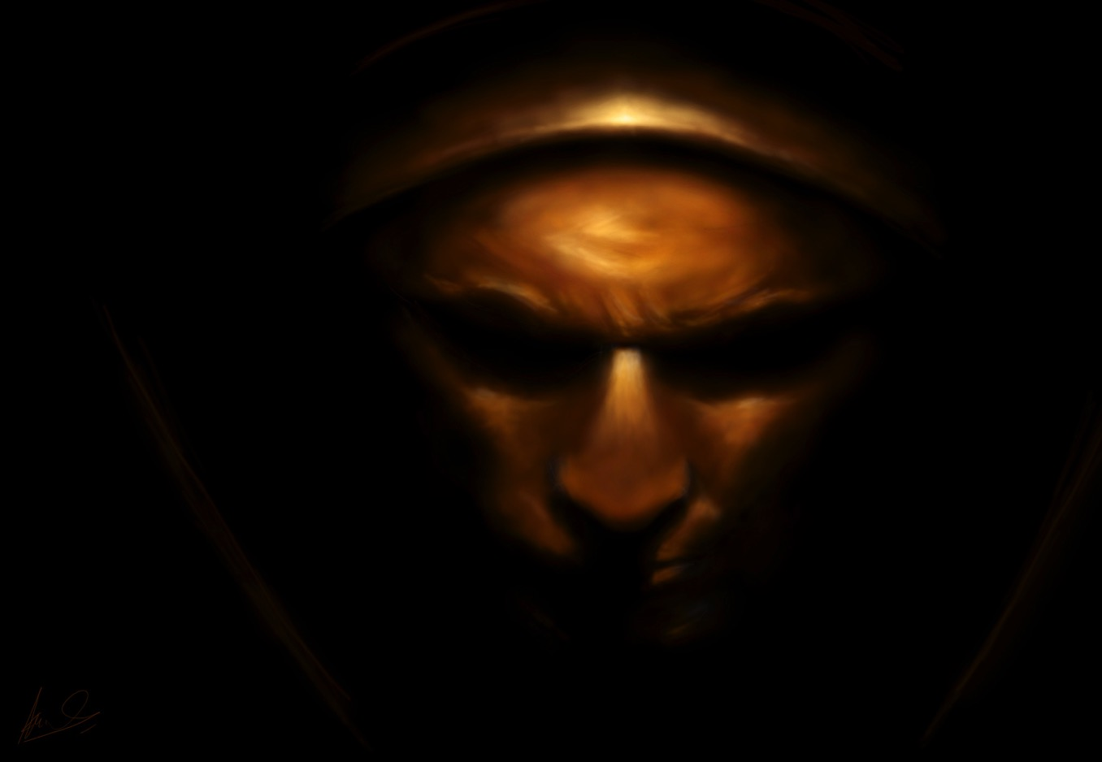
Bowl #5: Darkness (16:10-11)
"Then the fifth angel poured out his bowl on the throne of the beast, and his kingdom was plunged into darkness. His subjects ground their teeth in anguish, ¹¹and they cursed the God of heaven for their pains and sores. But they did not repent of their evil deeds and turn to God" (NLT).
393

Slide 47
Bowl Judgments (Rev. 16)
392
6
Used with permission

Slide 48
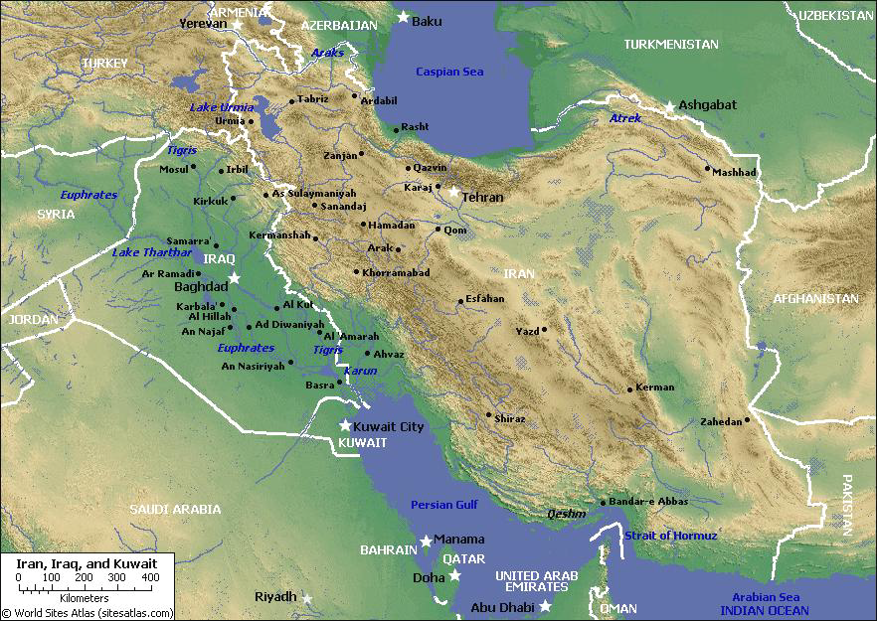
The Dried Euphrates (Bowl #6)
393
Who are the kings of the East?
Revelation 16:12
"The sixth angel poured out his bowl on the great river Euphrates, and its water was dried up to prepare the way for the kings from the East."
100 commentaries
57 interpretations!
Notes:
48

Slide 49
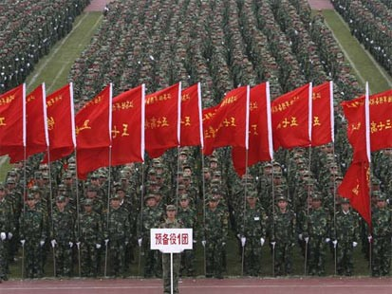
Who are the Kings of the East?
394
Notes:
49
No one really knows the identity of the army of 200 million. Traditionally this was thought to be China…

Slide 50
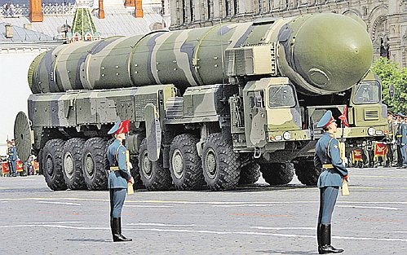
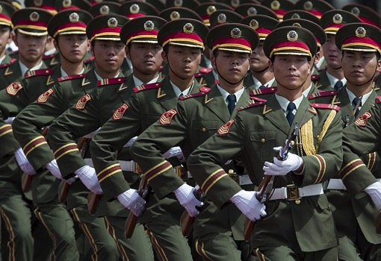
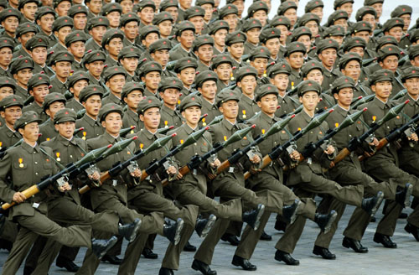
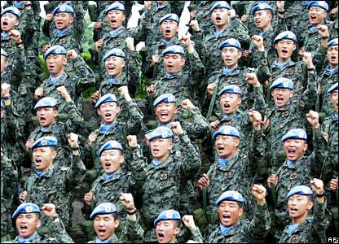
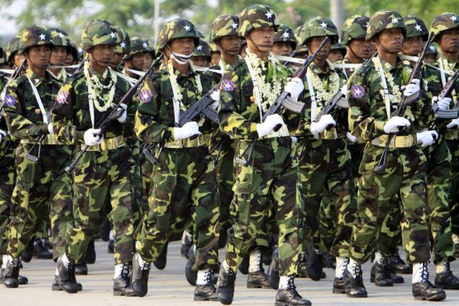
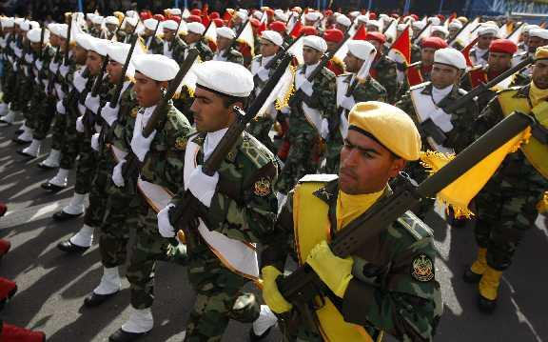
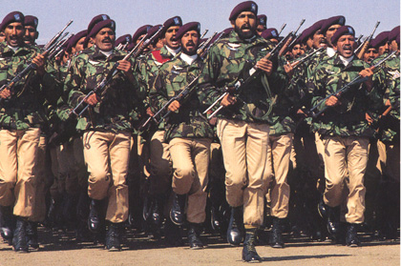
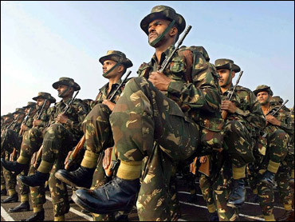
Who are the Kings of the East?
394
China?
North Korea?
Russia?
Myanmar?
South Korea?
Iran?
Pakistan?
India?
Notes:
50
But no one really knows the identity of the army of 200 million. Note that these are KINGS (plural), so many other armies could be included. 8 of the 10 largest armies of the world are east of Israel! www.bizbrowse.com/wordpress/2012/pages/1/top_ten_armies.html

Slide 51
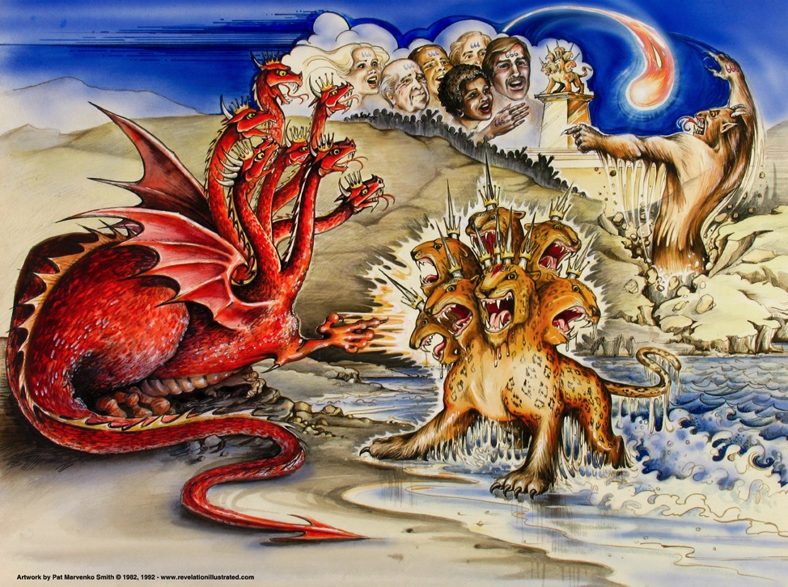
Beasts of Rev. 13
387
Dragon = Satan
Land Beast = False Prophet
Sea Beast = Antichrist
Used with permission
Notes:
Slide 83 is adapted from Rev 1 intro slide
Slides 84-91 copied from Rev 20-22 presentation

Slide 52
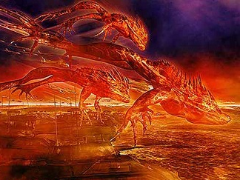
"And I saw three evil spirits that looked like frogs leap from the mouths of the dragon, the beast, and the false prophet. ¹⁴They are demonic spirits who work miracles and go out to all the rulers of the world to gather them for battle against the Lord on that great judgment day of God the Almighty" (16:13-14 NLT).
393

Slide 53
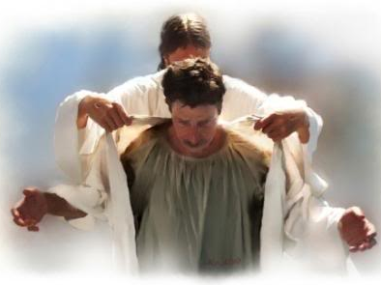
Bowl #6: Warning from Christ (16:15)
"Look, I will come as unexpectedly as a thief! Blessed are all who are watching for me, who keep their clothing ready so they will not have to walk around naked and ashamed" (NLT).

Slide 54
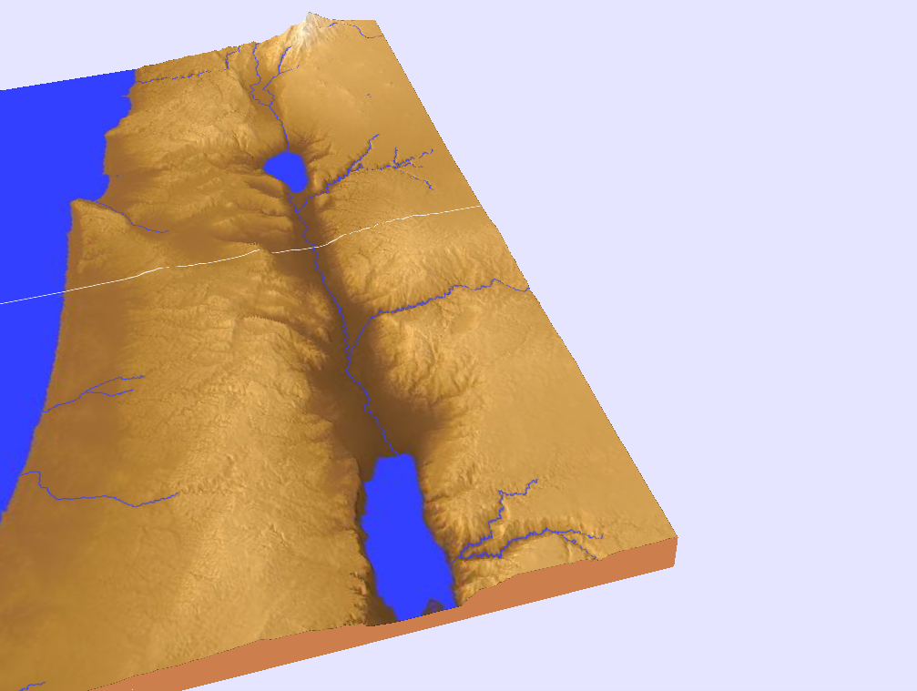
The Campaign of Armageddon (16:16 NLT)
394
Har ("hill") +
Megiddo ("place of troops" or "place of slaughter")
"And the demonic spirits gathered all the rulers and their armies to a place with the Hebrew name Armageddon (Har-magedon NAU)"
Notes:
"The name Armageddon comes from two Hebrew words, har Megiddo, the hill of Megiddo. The word Megiddo means 'place of troops' or 'place of slaughter.' It is also called the Plain of Esdraelon and the Valley of Jezreel. The area is about fourteen miles wide and twenty miles long, and forms what Napoleon called “the most natural battlefield of the whole earth.” Standing on Mount Carmel and overlooking that great plain, you can well understand why it would be used for gathering the armies of the nations.
It was on this plain that Barak defeated the armies of Canaan (Jud. 5:19). Gideon met the Midianites there (Jud. 7) and it was there that King Saul lost his life (1 Sam. 31). Titus and the Roman army used this natural corridor, as did the Crusaders in the Middle Ages. British General Allenby used it when he defeated the Turkish armies in 1917.
From a human viewpoint, it appears that the armies of the nations are gathering on their own; but John makes it clear that the military movement is according to God's plan. The satanic trinity, through demonic powers, will influence the nations and cause the rulers to assemble their armies. They will even work miracles that will impress the rulers and cause them to cooperate. But all this will merely fulfill the will of God and accomplish His purposes (see Rev. 17:17). The Gentile nations will look on Armageddon as a battle, but to God, it will be only a 'supper' for the fowls of the air (Rev. 19:17–21)" (Wiersbe).

Slide 55
Bowl Judgments (Rev. 16)
392
7
Used with permission

Slide 56
Bowl #7: The Final Judgment (16:17)
"Then the seventh angel poured out his bowl into the air. And a mighty shout came from the throne in the Temple, saying, 'It is finished!'" (NLT).

Slide 57
Bowl #7 (Rev. 16:18-19a NLT)
395
"Then the thunder crashed and rolled, and lightning flashed. And a great earthquake struck—the worst since people were placed on the earth. ¹⁹The great city of Babylon split into three sections, and the cities of [the] nations fell into heaps of rubble."
Notes:
The cities of "many" (NLT) changed to the Greek text of "the cities of the nations…"

Slide 58
Bowl #7 (Rev. 16:19b-20 NLT)
395
"So God remembered all of Babylon’s sins, and he made her drink the cup that was filled with the wine of his fierce wrath. ²⁰And every island disappeared, and all the mountains were leveled."

Slide 59
75-125 Pound Hailstones
395
Revelation 16:21 (Bowl #7)
"There was a terrible hailstorm, and hailstones weighing seventy-five pounds ("100 pounds," NAU) fell from the sky onto the people below. They cursed God because of the terrible plague of the hailstorm" (NLT).
The largest single hailstone ever recorded in the United States was 7" in diameter, 18.75" around, and weighed in at just under 1 pound. Imagine a large cantaloupe falling from the sky at nearly 100 miles per hour! That hailstone fell during a storm in Aurora, Nebraska. The heaviest hailstone in the U.S. was 1.67 pounds and fell in Coffeyville, Kansas in 1970.
Notes:
http://myweathercontent.myweather.net/webhd/pkg/v2/template3.html?host=whio&section=4&page=42&story=350

Slide 60
Why does God have the right to judge the world?
Why?

Slide 61
Main Idea
God is holy and Jesus is returning!

Slide 62
I. God alone is holy (Rev. 15).
Why does God have the right to judge the world?

Slide 63
II. Christ will judge the earth through seven bowls before he returns (Rev. 16).
391
How will God judge the world?
1st
2nd
3rd
4th
5th
6th
7th
Sores afflict those who accepted the mark of the Beast (16:2)
Sea turns to blood; all sea creatures die (16:3)
Rivers turn to blood (16:4-7)
Mankind scorched by the sun, blasphemes God (16:8-9)
The Beast's seat of govern-ment is afflicted (16:10-11)
The Euphrates is dried up; world armies gather to Arma-geddon (16:12-16)
The earth is utterly shaken (16:17-21)

Slide 64
Do you acknowledge Christ’s authority over this world in the future?
392
Used with permission

Slide 65
Do you acknowledge Christ’s authority over your own life right now?
392

Slide 67
Jesus Wins!
Series on Revelation

Slide 68
NT Preaching link at BibleStudyDownloads.org
Get this presentation and script for free!
Notes:
NT Preaching (np)

